Slide 1
Chapter 5:
Electronic Power Conversion

Slide 2
Why power electronics converters?
Thermal and hydro generation
Mechanical power from prime mover is controllable
Can control prime mover to rotate at constant speed
Synchronous generator then produces constant frequency ac
Wind and photovoltaic power generation
Primary power source is variable
Wind: prime mover rotates at variable speed
PV: no prime mover, produces dc instead of ac

Slide 3
Why power electronics converters?
Convert dc into ac
Convert variable frequency ac into constant frequency ac
Control the amount of active power injected into the grid
Control the amount of reactive power injected into the grid
Extract power at one location in the grid and inject it at another via an HVDC link

Slide 4


Ideal Switch
$$i$$
Switch closed: no voltage drop
Switch open: no current
Bidirectional:
Power can flow in both directions
Can carry large currents when closed
Can block large voltages when open
Controllable
Easy to turn on and off
Fast switching for better power control
Minimum amount of power to open or close the switch
Closed switch
No losses
$$v$$
Open switch
A switch that has all these characteristics has not yet been invented

Slide 5
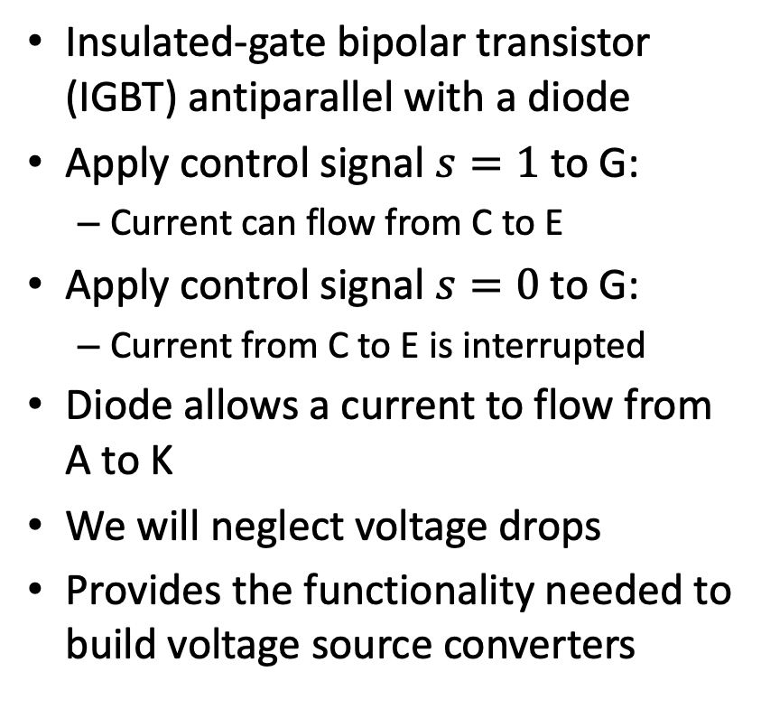
Reverse-conducting switching cell
Insulated-gate bipolar transistor (IGBT) antiparallel with a diode
Apply control signal $s=1$ to G:
Current can flow from C to E
Apply control signal $s=0$to G:
Current from C to E is interrupted
Diode allows a current to flow from A to K
We will neglect voltage drops
Provides the functionality needed to build voltage source converters
C
K
G
A
E

Slide 6




Single-phase H-Bridge converter
dc subsystem
Q₁
Q₃
Interface a dc subsystem with an ac subsystem
s₁
D₁
s₃
D₃
$$V_{S}(t)$$
+
-
ac subsystem
$$V_{dc}$$
i
$$L$$
Q₄
$$V_{ac}(t)$$
Q₂
s₄
D₄
s₂
D₂

Slide 7

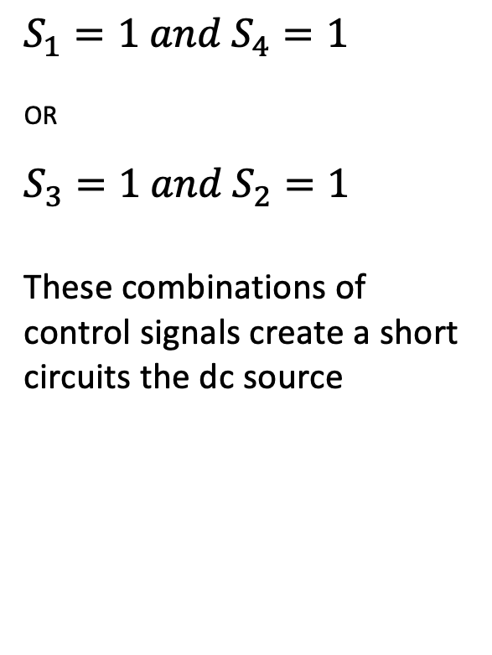


Forbidden combinations of control signals
$$S_{1}=1 and{ S}_{4}=1$$
_{OR}
$$S_{3}=1 and{ S}_{2}=1$$
These combinations of control signals create a short circuits the dc source
dc subsystem
Q₁
Q₃
s₁
D₁
s₃
D₃
$$V_{S}(t)$$
+
-
ac subsystem
$$V_{dc}$$
i
$$L$$
Q₄
$$V_{ac}(t)$$
Q₂
s₄
D₄
s₂
D₂

Slide 8

$$i>0;s_{1}=s_{2}=1; s_{3}=s_{4}=0$$
Current flows through Q₁ and Q₂
$V_{S}=+V_{dc}$
dc subsystem
Q₁
Q₃
s₁
D₁
s₃
D₃
$$V_{S}(t)$$
+
-
ac subsystem
$$V_{dc}$$
i
$$L$$
Q₄
$$V_{ac}(t)$$
Q₂
s₄
D₄
s₂
D₂

Slide 9

$$i<0;s_{1}=s_{2}=1;s_{3}=s_{4}=0$$
Current flows through D₁ and D₂
$$V_{S}=+V_{dc}$$
dc subsystem
Q₁
Q₃
s₁
D₁
s₃
D₃
$$V_{S}(t)$$
+
-
ac subsystem
$$V_{dc}$$
i
$$L$$
Q₄
$$V_{ac}(t)$$
Q₂
s₄
D₄
s₂
D₂

Slide 10


$$i>0;s_{1}=s_{2}=0;s_{3}=s_{4}=1$$
Current flows through D₄ and D₃
$$V_{S}=−V_{dc}$$
dc subsystem
Q₁
Q₃
s₁
D₁
s₃
D₃
$$V_{S}(t)$$
+
-
ac subsystem
$$V_{dc}$$
i
$$L$$
Q₄
$$V_{AC}(t)$$
Q₂
s₄
D₄
s₂
D₂

Slide 11

$$i<0;s_{1}=s_{2}=0;s_{3}=s_{4}=1$$
Current flows through Q₃ and Q₄
$$V_{S}=−V_{dc}$$
dc subsystem
Q₁
Q₃
s₁
D₁
s₃
D₃
$$V_{S}(t)$$
+
-
ac subsystem
$$V_{dc}$$
i
$$L$$
Q₄
$$V_{AC}(t)$$
Q₂
s₄
D₄
s₂
D₂

Slide 12
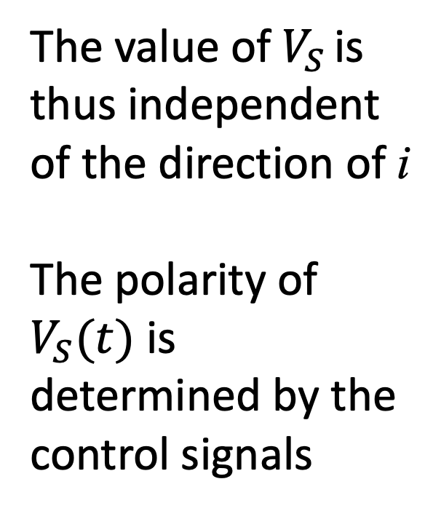
Operation of the single-phase H-Bridge converter
dc subsystem
The value of $V_{S}$ is thus independent of the direction of i
The polarity of $V_{S}(t)$ is determined by the control signals
Q₁
Q₃
s₁
D₁
s₃
D₃
$$V_{S}(t)$$
+
-
ac subsystem
$$V_{dc}$$
i
$$L$$
Q₄
$$V_{ac}(t)$$
Q₂
s₄
D₄
s₂
D₂

Slide 13



















$V_{s}(t)$ as a function of the control signals
$$s_{1},s_{2}$$
1
0
$$t$$
$$0$$
$$\frac{T}{2}$$
$$T$$
$$\frac{3T}{2}$$
$$2T$$
$$\frac{5T}{2}$$
$$s_{3},s_{4}$$
1
0
$$t$$
$$V_{s}(t)$$
$$0$$
$$\frac{T}{2}$$
$$T$$
$$\frac{3T}{2}$$
$$2T$$
$$\frac{5T}{2}$$
+$V_{dc}$
0
$$t$$
-$V_{DC}$

Slide 14
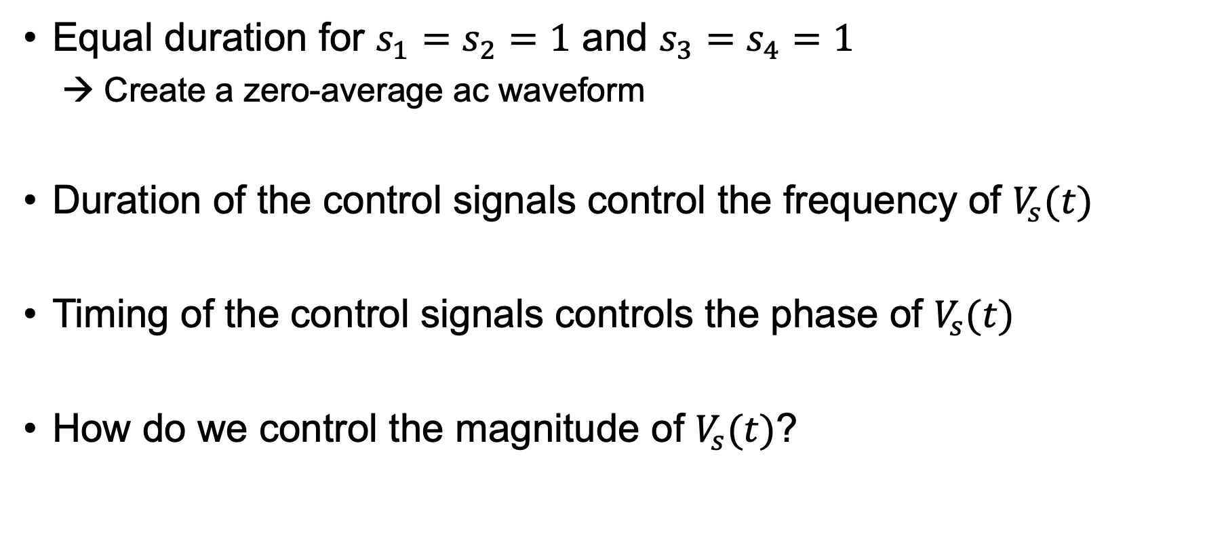
Shaping $V_{s}(t)$
Equal duration for $s_{1}=s_{2}=1$ and $s_{3}=s_{4}=1$
Create a zero-average ac waveform
Duration of the control signals control the frequency of $V_{s}(t)$
Timing of the control signals controls the phase of $V_{s}(t)$
How do we control the magnitude of $V_{s}(t)$?

Slide 15




Pulse Width Modulation (PWM)
Triangular carrier
Sinusoidal modulator
$$s_{1},s_{2}$$
1
Modulator < Carrier → $s_{3},s_{4}$ = 1
Modulator > Carrier → $s_{1},s_{2}$ = 1
0
$$s_{3},s_{4}$$
1
0

Slide 16


Pulse Width Modulation (PWM)
Triangular carrier
Sinusoidal modulator
+$V_{DC}$
Fundamental of
PWM waveform
0
PWM waveform
-$V_{DC}$

Slide 17


Pulse Width Modulation (PWM)
Frequency of the carrier is constant
Frequency of the fundamental of the PWM waveform is determined by the frequency of the modulator
+$V_{DC}$
0
-$V_{DC}$

Slide 18
Pulse Width Modulation (PWM)
Amplitude of carrier is constant
Amplitude of modulator determines amplitude of fundamental of PWM
+$V_{DC}$
0
-$V_{DC}$

Slide 19
Pulse Width Modulation (PWM)
Amplitude of carrier is constant
Amplitude of modulator determines amplitude of fundamental of PWM

Slide 20


Pulse Width Modulation (PWM)
We will consider only the fundamental of the PWM waveform
Filters are usually added to manage the harmonics
+$V_{DC}$
0
-$V_{DC}$

Slide 21
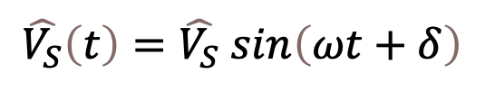
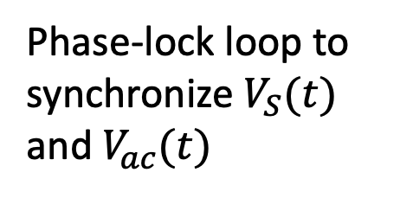
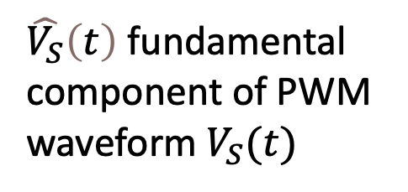
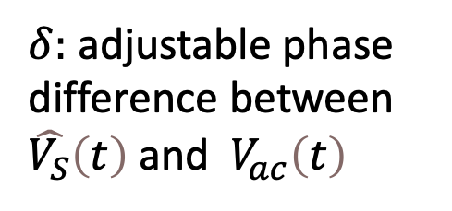

Single-Phase H-Bridge converter
$\hat{V_{S}}\left(t\right)$ fundamental component of PWM waveform $V_{S}(t)$
dc subsystem
Q₁
Q₃
Phase-lock loop to synchronize $V_{S}(t)$ and $V_{ac}(t)$
s₁
D₁
s₃
D₃
$$V_{S}(t)$$
+
-
ac subsystem
$$V_{dc}$$
i
$$L$$
$$V_{ac}\left(t\right)=V_{ac} sinωt$$
Q₄
$$V_{ac}(t)$$
Q₂
$$\hat{V_{S}}\left(t\right)=\hat{V_{S}} sin\left(ωt+δ\right)$$
s₄
D₄
s₂
D₂
$δ:$ adjustable phase difference between $\hat{V_{S}}\left(t\right)$ and ${ V}_{ac}\left(t\right)$

Slide 22



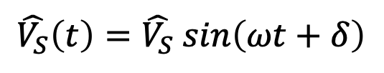

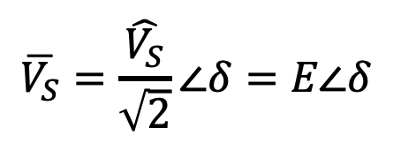
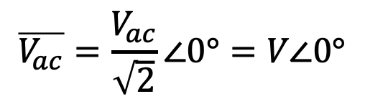

Steady state converter model
$$\overline{V_{ac}}=\frac{V_{ac}}{\sqrt{2}}∠0°=V∠0°$$
$$V_{ac}\left(t\right)=V_{ac} sinωt$$
$$\overline{V_{S}}=\frac{\hat{V_{S}}}{\sqrt{2}}∠δ=E∠δ$$
$$\hat{V_{S}}\left(t\right)=\hat{V_{S}} sin\left(ωt+δ\right)$$
$$X=ωL$$
$$\overline{I}$$
$$\overline{V_{S}}=E∠δ$$
$$\overline{V_{ac}}=V∠0°$$

Slide 23

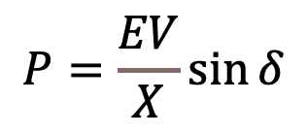
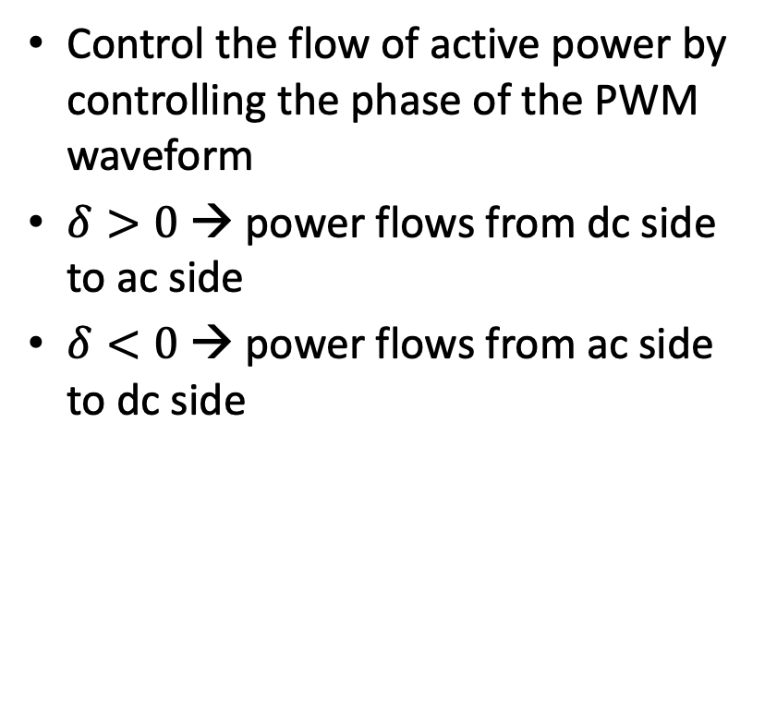



Active power control
Control the flow of active power by controlling the phase of the PWM waveform
$δ>0$ → power flows from dc side to ac side
$δ<0$ → power flows from ac side to dc side
$$X=ωL$$
$$\overline{I}$$
$$\overline{V_{S}}=E∠δ$$
$$\overline{V_{AC}}=V∠0°$$
$$P=\frac{EV}{X}\sin{δ}$$

Slide 24
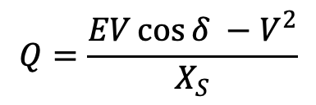
Reactive power control
Control the flow of reactive power by controlling the magnitude of the fundamental of the PWM waveform
$$X=ωL$$
$$\overline{I}$$
$$\overline{V_{S}}=E∠δ$$
$$\overline{V_{AC}}=V∠0°$$
$$Q=\frac{EV\cos{δ} −V^{2}}{X_{S}}$$

Slide 25










More realistic model of the dc subsystem
dc subsystem
dc subsystem
$$P_{dc}(t)$$
Q₁
Q₃
Q₁
Q₃
s₁
D₁
s₃
D₃
s₁
D₁
s₃
D₃
$$V_{S}(t)$$
Power Source
$$V_{S}(t)$$
+
-
ac subsystem
$$P_{AC}(t)$$
ac subsystem
$$V_{dc}$$
i
$$L$$
$$V_{dc}(t)$$
$$L$$
Q₄
$$V_{ac}(t)$$
Q₂
Q₄
$$V_{dc}(t)$$
Q₂
s₄
D₄
s₂
D₂
s₄
D₄
s₂
D₂
Modeled as ideal dc voltage source
Example: PV panel
Constant voltage for any current
Power $P_{dc}(t)$ is variable
Can supply or absorb any amount of dc power
What happens if $P_{ac}\left(t\right)≠P_{dc}\left(t\right)$?

Slide 26

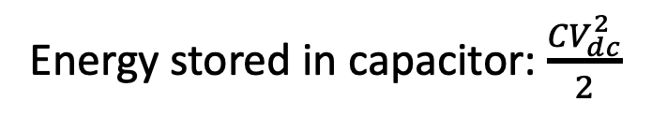



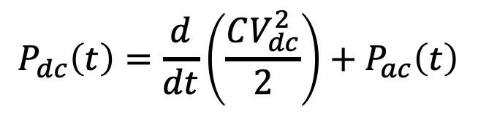
dc subsystem as a power source
dc subsystem
Capacitor serves as an energy buffer
$$P_{dc}(t)$$
Q₁
Q₃
s₁
D₁
s₃
D₃
Energy stored in capacitor: $\frac{CV_{dc}^{2}}{2}$
$$V_{S}(t)$$
Power Source
$$P_{ac}(t)$$
ac subsystem
$$V_{dc}(t)$$
$$P_{dc}\left(t\right)=\frac{d}{dt}\left(\frac{CV_{dc}^{2}}{2}\right)+P_{ac}\left(t\right)$$
Q₄
$$V_{ac}(t)$$
Q₂
s₄
D₄
s₂
D₂
$P_{ac}\left(t\right)$ is regulated to keep $V_{dc}$ constant → $P_{ac}$ follows $P_{dc}$

Slide 27






Three-phase voltage source converter
dc subsystem
$$P_{dc}$$
Q₁
Q₃
Q₅
s₁
D₁
s₃
D₃
s₅
D₅
ac subsystem
Power Source
$$L$$
$$\overline{V_{an}}$$
$$\overline{V_{bn}}$$
$$V_{dc}$$
$$\overline{V_{cn}}$$
Q₄
Q₆
Q₂
s₄
D₄
s₆
D₆
s₂
D₂

Slide 28
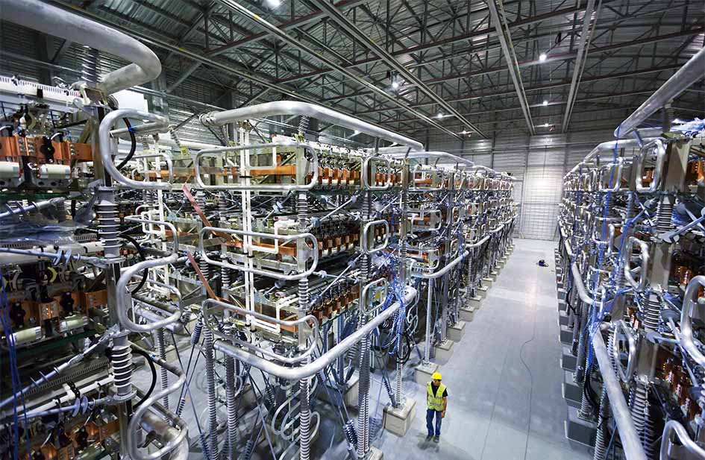
Applications of Power electronics in Power Systems

Slide 29





Battery energy storage
$$P_{dc}$$
$$P_{ac},Q_{ac}$$
Converter
Grid
Battery
+
$$V_{dc}$$
–
$$P_{ref}$$
$$Q_{ref}$$

Slide 30


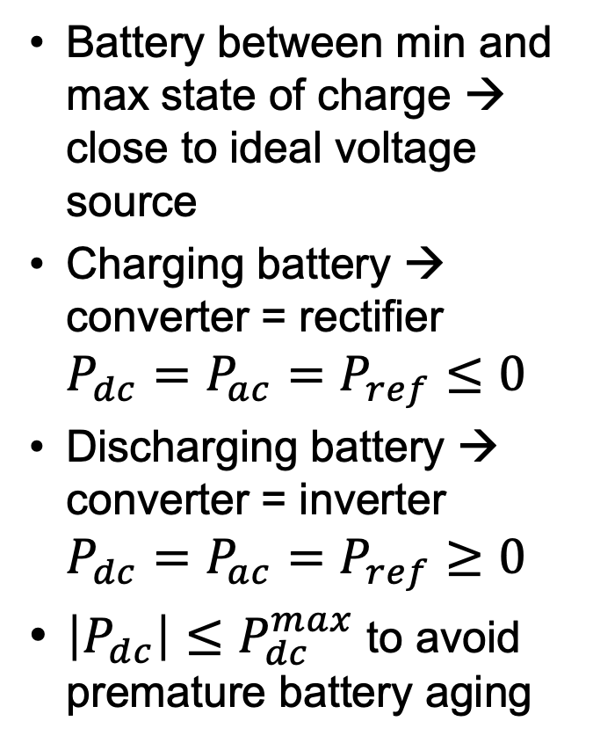



Battery energy storage – active power
$$P_{dc}$$
$$P_{ac},Q_{ac}$$
Battery between min and max state of charge → close to ideal voltage source
Charging battery → converter = rectifier $P_{dc}=P_{ac}=P_{ref}≤0$
Discharging battery → converter = inverter $P_{dc}=P_{ac}=P_{ref}≥0$
$\left|P_{dc}\right|≤P_{dc}^{max}$ to avoid premature battery aging
Converter
Grid
Battery
+
$$V_{dc}$$
–
$$P_{ref}$$
$$Q_{ref}$$

Slide 31


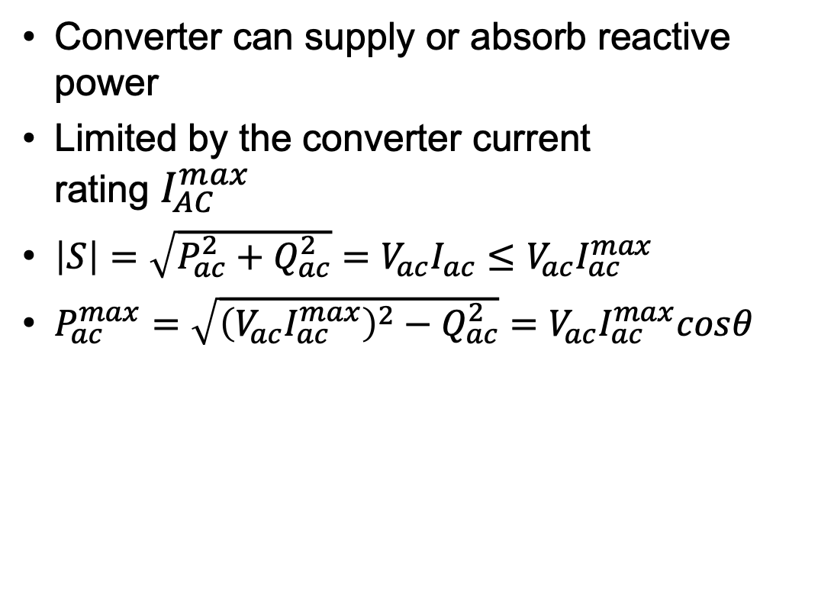



Battery energy storage – reactive power
$$P_{dc}$$
$$P_{ac},Q_{ac}$$
Converter can supply or absorb reactive power
Limited by the converter current rating $I_{AC}^{max}$
$\left|S\right|=\sqrt{P_{ac}^{2}+Q_{ac}^{2}}=V_{ac}I_{ac}≤V_{ac}I_{ac}^{max}$
$P_{ac}^{max}=\sqrt{{\left(V_{ac}I_{ac}^{max}\right)}^{2}−Q_{ac}^{2}}=V_{ac}I_{ac}^{max}cosθ$
Battery
Converter
Grid
+
$$V_{dc}$$
–
$$P_{ref}$$
$$Q_{ref}$$

Slide 32



Photovoltaic (PV) generation
$$P_{dc}$$
$$P_{ac},Q_{ac}$$
Converter
Grid
PV Array
$$V_{dc}$$
$P_{dc}$ is a complex function of the irradiance and the temperature of the cells
→ The maximum value of $P_{dc}$ changes constantly → need to adapt $V_{dc}$

Slide 33


What value of $V_{dc}$ gives $P_{max}$?
$$P_{dc}$$
Two different values of solar irradiance
$$V_{dc}$$

Slide 34


Maximum Power Point Tracking
$$P_{dc}$$
$$P_{ac},Q_{ac}$$
Converter
Grid
PV Array
$$V_{dc}$$
MPPT
$$V_{dc ref}$$
$$Q_{ref}$$

Slide 35




Perturb and Observe technique
Maximum power point
$$P_{dc}$$
$$P_{max}$$
$$V_{dc}^{∗}$$
$$V_{dc}$$

Slide 36
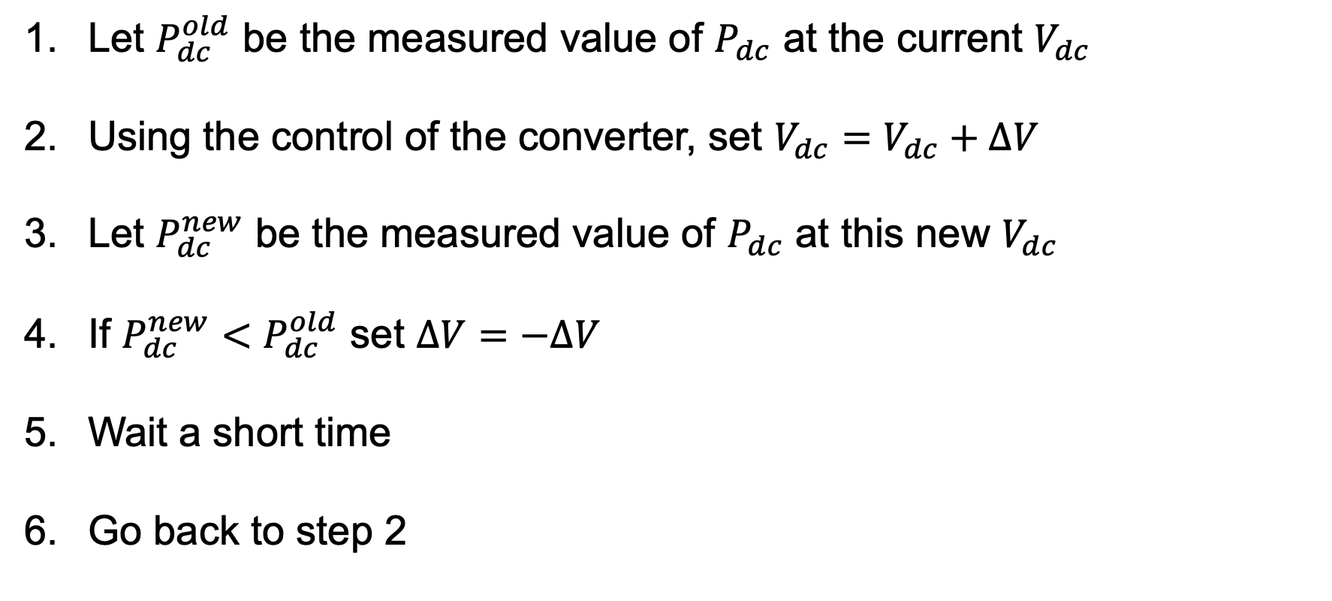
Perturb and Observe algorithm
Let $P_{dc}^{old}$ be the measured value of $P_{dc}$ at the current $V_{dc}$
Using the control of the converter, set $V_{dc}=V_{dc}+ΔV$
Let $P_{dc}^{new}$ be the measured value of $P_{dc}$ at this new $V_{dc}$
If $P_{dc}^{new}<P_{dc}^{old}$ set $ΔV=−ΔV$
Wait a short time
Go back to step 2

Slide 37
Wind generation
Optimal turbine speed depends on the wind speed
Rotational speed of a synchronous generator is proportional to grid frequency
Connecting a wind turbine to the grid directly with a synchronous generator is not possible
Type 4 wind turbine
Use the synchronous generator to produce variable frequency ac
Rectify this ac into dc
Convert dc into fixed frequency ac

Slide 38






Type 4 wind turbine
$$P_{ac}$$
$$P_{dc}$$
$$P_{ac},Q_{ac}$$
Synchronous generator
Converter 1: Rectifier
Converter 2: Inverter
Grid
Gearbox
1:G
$$V_{DC}$$
$$ω_{v}$$
-
Wind Speed
Reg
Reg
+
$$Q_{ref}$$
$$V_{dc ref}$$

Slide 39
Type 4 wind turbine
Advantages
Excellent controllability
No slip rings if permanent magnet synchronous generator
Direct drive turbines don’t use a gearbox
Disadvantage
High cost because two converters rated at maximum power are needed
Technology of choice for largest wind turbines
Offshore wind turbines in particular

Slide 40
Type 3 wind turbine
Uses an induction generator rather than a synchronous generator
Induction generator
Stator: three-phase windings like synchronous generator
Rotor: three-phase winding
Rotor speed is not fixed by the frequency of the voltage on the stator

Slide 41

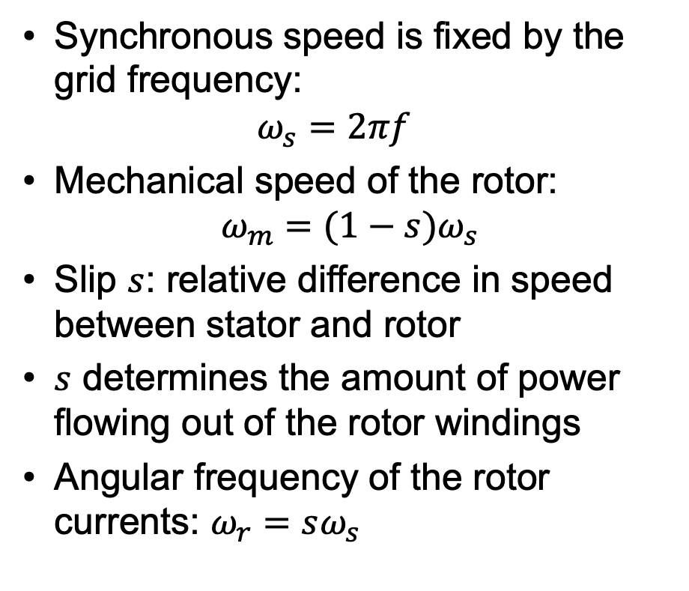

Induction generator
Synchronous speed is fixed by the grid frequency: $ω_{s}=2πf$
Mechanical speed of the rotor: $ω_{m}=(1−s)ω_{s}$
Slip $s$: relative difference in speed between stator and rotor
$s$ determines the amount of power flowing out of the rotor windings
Angular frequency of the rotor currents: $ω_{r}=sω_{s}$
stator
$$ω_{m}$$
$$ω_{s}$$
Grid
rotor

Slide 42
Type 3 wind turbine
Grid
Power through the stator
Wind Turbine
Mechanical power from wind turbine
Induction Generator
Converter
Power through the rotor
Speed control

Slide 43







Type 3 wind turbine
$$P_{s}$$
$$ω_{s}$$
$$P_{g}$$
$$ω_{s}$$
Grid
Gearbox
Stator
Slip rings
$$P_{r}$$
$$ω_{s}$$
Rotor
1:G
Rotor Side Converter
Grid Side Converter
Transformer
$$P_{m}$$
$$ω_{m}$$
Stator
$$V_{DC}$$
$$P_{r}$$
$$ω_{r}$$
$$ω_{r}$$
Wind Speed
Reg

Slide 44
Type 3 wind turbine
Advantages
Since the rotor carries only a fraction of the rated power of the turbine, the ratings of the converters can be much smaller
Disadvantages
Requires slip rings
Requires a gearbox
Used for smaller wind turbines

Slide 45
High Voltage dc links
Back-to-back link or dc line
Applications:
Connection between two power systems operating at different frequencies
Undersea power cables longer than 50 km
Transmission of a lot of power over a long distance
Examples:
dc intertie between the Pacific Northwest and Los Angeles
dc links between US Eastern and Western interconnections
Multiple cables under the North Sea and the Baltic Sea in Europe
dc link between the 50Hz and 60HZ systems in Japan

Slide 46







High Voltage dc Link
$$P_{1},Q_{1}$$
$$P_{dc}$$
$$P_{2},Q_{2}$$
Converter 1
dc link
Converter 2
Grid 1
Grid 2
$$V_{DC}$$
-
Reg
$$P_{ref1}$$
$$Q_{ref1}$$
$$Q_{ref2}$$
+
$$V_{dc ref}$$

